Slide 1

SE401 - Software Quality Assurance and Testing
Software Testing Life Cycle (STLC)

Slide 2
Outlines
What is Software Testing Life Cycle (STLC)?
Difference between Test Scenario, Test Case, and Test Data
How to create a Requirement Traceability Matrix (RTM).
Test Plan vs Test Strategy
Summary

Slide 3
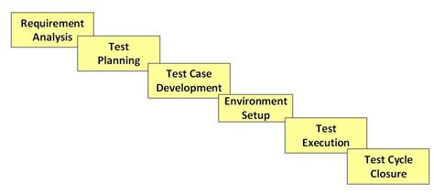
STLC – An overview
Is Software Testing a Single activity?
No… Software Testing consists of series of activities carried out methodologically to help certify your software product.
These activities constitute the Software Testing Life Cycle (STLC)
STLC Model Phases

Slide 4
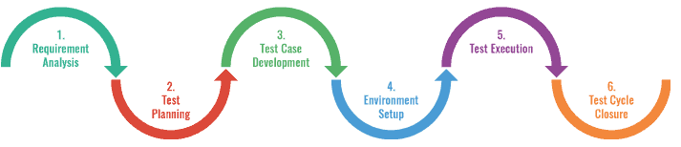
STLC: 1. Requirement Analysis
During this phase, test team studies the requirements from a testing point of view to identify the testable requirements.
Requirements could be either Functional (defining what the software must do) or Non Functional (defining how the software behave )
Automation feasibility for the given testing project is also done in this stage

Slide 5
STLC: 1. Requirement Analysis
Activities:
Identify types of tests to be performed.
Gather details about testing priorities and focus.
Prepare Requirement Traceability Matrix (RTM).
Identify test environment details where testing is supposed to be carried out.
Automation feasibility analysis (if required).

Slide 6
STLC: 1. Requirement Analysis
Output:
Requirement Traceability Matrix (RTM) - see slide 32
Automation feasibility report. (if needed)

Slide 7
STLC: 2. Test Planning
In this stage, a Senior QA manager will determine effort and cost estimates for the project and would prepare and finalize the Test Plan. In this phase, Test Strategy is also determined.

Slide 8
STLC: 2. Test Planning
Activities:
Preparation of test plan/strategy document for various types of testing
Test tool selection
Test effort estimation
Resource planning and determining roles and responsibilities.
Training requirement

Slide 9
STLC: 2. Test Planning
Output:
Test plan/strategy document.
Effort estimation document.

Slide 10
STLC: 3. Test Case Development
This phase involves creation, verification and rework of test cases. Test data , is also identified/created and is reviewed and then reworked as well.

Slide 11
STLC: 3. Test Case Development
Activities:
Create test cases, automation scripts (if applicable)
Review test cases and scripts
Create test data (If Test Environment is available)

Slide 12
STLC: 3. Test Case Development
Output:
Test cases/scripts
Test data

Slide 13
STLC: 4. Test Environment Setup
Test environment decides the software and hardware conditions under which a work product is tested.
Test environment set-up is one of the critical aspects of testing process and can be done in parallel with Test Case Development Stage.
If the customer provides the test environment, the test team is required to do a readiness check (smoke testing) of the given environment.

Slide 14
STLC: 4. Test Environment Setup
Activities:
Understand the required architecture, environment set-up and prepare hardware and software requirement list for the Test Environment.
Setup test Environment and test data
Perform smoke test on the build (will be explained later in the course)

Slide 15
STLC: 4. Test Environment Setup
Output:
Environment ready with test data set up
Smoke Test Results.

Slide 16
STLC: 5. Test Execution
During this phase the testers will carry out the testing based on the test plans and the test cases prepared.
Bugs will be reported back to the development team for correction and retesting will be performed.

Slide 17
STLC: 5. Test Execution
Activities:
Execute tests as per plan
Document test results, and log defects for failed cases
Map defects to test cases in RTM
Retest the Defect fixes
Track the defects to closure

Slide 18
STLC: 5. Test Execution
Output:
Completed RTM with execution status
Test cases updated with results
Defect reports

Slide 19
STLC: 6. Test Cycle Closure
Testing team will meet , discuss and analyze testing artifacts to identify strategies that have to be implemented in future, taking lessons from the current test cycle.
The idea is to remove the process bottlenecks for future test cycles and share best practices for any similar projects in future.

Slide 20
STLC: 6. Test Cycle Closure
Activities:
Evaluate cycle completion criteria based on Time, Test coverage, Cost, Software, Critical Business Objectives, Quality
Prepare test metrics based on the above parameters
Document the learning outcomes of the project
Prepare Test closure report

Slide 21
STLC: 6. Test Cycle Closure
Output:
Test closure report
Test metrics (will be discussed later in the course)

Slide 22
STLC Summary
STLC Stage | Entry Criteria | Activity | Exit Criteria | Deliverables
1. Requirement Analysis | Requirements Document available (both functional and non functional) Acceptance criteria defined. Application architectural document available. | Analyse business functionality to know the business modules and module specific functionalities. Identify all transactions in the modules. Identify all the user profiles. Gather user interface/ authentication, geographic spread requirements. Identify types of tests to be performed. Gather details about testing priorities and focus. Prepare RequirementTraceability Matrix (RTM). Identify test environment details where testing is supposed to be carried out. Automation feasibility analysis (if required). | Signed off RTM Test automation feasibility report signed off by the client | RTM Automation feasibility report (if applicable)
2. Test Planning | Requirements Documents Requirement Traceability matrix. Test automation feasibility document. | Analyze various testing approaches available Finalize on the best suited approach Preparation of test plan/strategy document for various types of testing Test tool selection Test effort estimation Resource planning and determining roles and responsibilities. | Approved test plan/strategy document. Effort estimation document signed off. | Test plan/strategy document. Effort estimation document.

Slide 23
STLC Summary
STLC Stage | Entry Criteria | Activity | Exit Criteria | Deliverables
3. Test case development | Requirements Documents RTM and test plan Automation analysis report | Create test cases, test design, automation scripts (where applicable) Review and baseline test cases and scripts Create test data | Reviewed and signed test Cases/scripts Reviewed and signed test data | Test cases/scripts Test data
4. Test Environment setup | System Design and architecture documents are available Environment set-up plan is available | Understand the required architecture, environment set-up Prepare hardware and software development requirement list Finalize connectivity requirements Prepare environment setup checklist Setup test Environment and test data Perform smoke test on the build Accept/reject the build depending on smoke test result | Environment setup is working as per the plan and checklist Test data setup is complete Smoke test is successful | Environment ready with test data set up Smoke Test Results.

Slide 24
STLC Summary
STLC Stage | Entry Criteria | Activity | Exit Criteria | Deliverables
5. Test Execution | Baselined RTM, Test Plan , Test case/scripts are available Test environment is ready Test data set up is done Unit/Integration test report for the build to be tested is available | Execute tests as per plan Document test results, and log defects for failed cases Update test plans/test cases, if necessary Map defects to test cases in RTM Retest the defect fixes Regression Testing of application Track the defects to closure | All tests planned are executed Defects logged and tracked to closure | Completed RTM with execution status Test cases updated with results Defect reports
6. Test Cycle closure | Testing has been completed Test results are available Defect logs are available | Evaluate cycle completion criteria based on - Time, Test coverage , Cost , Software Quality , Critical Business Objectives Prepare test metrics based on the above parameters. Document the learning out of the project Prepare Test closure report Qualitative and quantitative reporting of quality of the work product to the customer. Test result analysis to find out the defect distribution by type and severity | Test Closure report signed off by client | Test Closure report Test metrics

Slide 25
Important Testing Terms
It is important to understand the difference between following terms:
Test scenario
Test case
Test data
Test suite

Slide 26
Important Testing Terms (Test Scenario)
A Test Scenario: Is any functionality of the product that can be tested.
Creating Test Scenarios ensures complete test coverage
Example - for a course registration system possible test scenarios can be:
Check the log-in functionality
Check that a student can add a course
Check that a student can drop a course
What else???? Think of more test scenarios ….

Slide 27
Important Testing Terms (Test Scenario)
How to create a Test Scenario
Step 1: Read the Requirement Documents like BRS, SRS, FRS, of the application to be tested.
Step 2: For each requirement, figure out possible users actions and objectives
Step 3: After reading the Requirements Document and doing your due analysis, list out different test scenarios that verify each feature of the software.
Step 4: Once you have listed all possible test scenarios, a traceability matrix is created to verify that each & every requirement has a corresponding test scenario
Step 5: The scenarios created are reviewed by your supervisor. Later, they are also reviewed by other stakeholders in the project.

Slide 28
Important Testing Terms (Test Case)
A Test Case: is a set of actions executed to verify a particular functionality of the test software.
Example – consider the test scenario “Check the log-in functionality”, there are many possible cases like :
Test Case 1
Check results upon entering valid User ID & Password
Check Log-in Functionality
Test Case 2
Check results upon entering Invalid User ID & Password
Test Case 3
Check response when User ID is Empty & Login Button is pressed
Test Scenario
Many more

Slide 29
Important Testing Terms (Test Case)
Format of Standard Test Cases
* Test Case ID | Test Case | Test Steps | Test Data | Expected Results | Actual Results | Pass/ Fail
TU01 | Check Customer Login with valid Data | Go to site http://demo.guru99.com Enter UserId Enter Password Click Submit | Userid = guru99 Password = pass99 | User should Login into application | As Expected | Pass
TU02 | Check Customer Login with invalid Data | Go to site http://demo.guru99.com Enter UserId Enter Password Click Submit | Userid = guru99 Password = glass99 | User should not Login into application | As Expected | Pass

Slide 30
How to Write Good Test Cases ?
Test Cases need to be simple and transparent
Create Test Cases with end user in mind
Think about all possible inputs (valid and invalid)
Think about expected output
Avoid test case repetition
Do not assume
Stick to the Specifications Document

Slide 31
How to Write Good Test Cases ?
Ensure 100% Coverage for the requirements in the SRS
Test Cases must be identifiable
Implement Testing Techniques to help you select test cases
It's not possible to check every possible condition in your software application. Testing techniques (e.g. Equivalence Class Partitioning, or Boundary Value Analysis) help you select a few test cases with the maximum possibility of finding a defect (will be covered later in the class)

Slide 32
Important Testing Terms (Test Data)
Test Data: is the input data used to execute the test case.
Example:
Test Scenario | Test Case | Test Data
Check log-in Functionality | Check response on entering valid user id and password. | User id: 1234 Password: pass1 User id: 3456 Password: pass2 User id: 5678 Password: pass3

Slide 33
Important Testing Terms (Test Suite)
Test Suite: is a collection of test cases that are intended to be used to test a software program

Slide 34
How to Create an RTM
What is RTM (Requirement Traceability Matrix)?
It is a matrix that maps and traces user requirement with test cases.
The main purpose of Requirement Traceability Matrix is to see that all requirements are covered so that no functionality is missed while doing Software testing.

Slide 35
How to Create an RTM
RTM Parameters include:
Requirement ID
Risks
Requirement Type and Description
Trace to design specification
Unit test cases
Integration test cases
System test cases
User acceptance test cases
Trace to test script

Slide 36
How to Create an RTM
Example * : assume that we have the following Business Requirement Document (BRD) and Technical Requirement Document (TRD) for a banking application.
(BRD)
BR# | Module Name | Applicable Roles | Description
B1 | Login and logout | Manager Customer | Customer: a customer can login using the login page Manager: a manager can login using the login page of a customer. Post login homepage will show different links based on role.
B2 | Enquiry | Manager Customer | Customer: customer can have multiple bank accounts. He can view balance of his accounts only Manager: Can view accounts of all customers
B3 | Fund transfer | Manager Customer | Customer: can transfer funds from his account to any other account Manager: can transfer funds from any account
* Source: https://www.guru99.com/traceability-matrix.html

Slide 37
How to Create an RTM
Example * : assume that we have the following Business Requirement Document (BRD) and Technical Requirement Document (TRD) for a banking application.
(TRD)
Login
T93 | User ID must not be blank
T94 | Password must not be blank
T95 | If user id and password are valid, Login.
* Source: https://www.guru99.com/traceability-matrix.html

Slide 38
How to Create an RTM
Step 1: Our Test Case is “"Verify Login, when correct ID and Password is entered, it should login successfully“
TestCase # | Test Case | Test Steps | Test Data | Expected Results
1 | Verify Login | Go to Login Page Enter UserID Enter Password Click Login | id= psu pass= 1234 | Login Successful

Slide 39
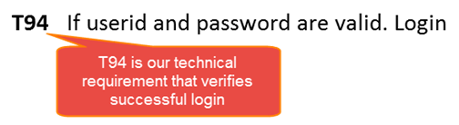
How to Create an RTM
Step 2: Identify the Technical Requirement that this test case is verifying. For our test case, the technical requirement is T94 is being verified.

Slide 40
How to Create an RTM
Step 3: Note this Technical Requirement (T94) in the Test Case.
TestCase # | TR# | Test Case | Test Steps | Test Data | Expected Results
1 | T94 | Verify Login | Go to Login Page Enter UserID Enter Password Click Login | id= psu pass= 1234 | Login Successful

Slide 41
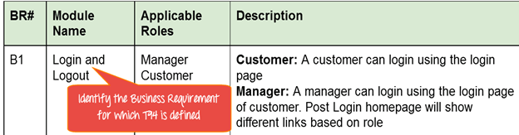
How to Create an RTM
Step 4: Identify the Business Requirement for which this TR (Technical Requirement-T94) is defined.

Slide 42
How to Create an RTM
Step 5: Note the BR (Business Requirement) in Test Case
TestCase # | BR# | TR# | Test Case | Test Steps | Test Data | Expected Results
1 | B1 | T94 | Verify Login | Go to Login Page Enter UserID Enter Password Click Login | id= psu pass= 1234 | Login Successful

Slide 43
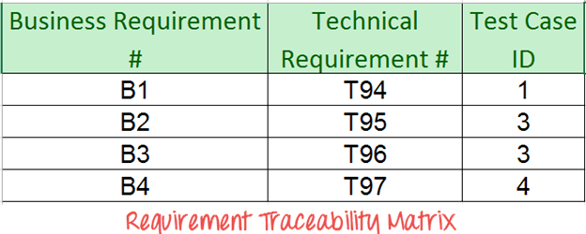
How to Create an RTM
Step 6: repeat the above steps for all Test Cases. Later Extract the First 3 Columns from your Test Suite to create the RTM.

Slide 44
Advantage of Requirement Traceability Matrix
It highlights any missing requirements or document inconsistencies
It shows the overall defects or execution status with a focus on business requirements
It helps in analyzing or estimating the impact on the QA team's work with respect to revisiting or re-working on the test cases

Slide 45
Test Plan vs Test Strategy
A Test Plan is defined as a document which outlines the scope, objective, method and weight on a software testing task
Test Strategy is defined as a set of guiding principles that determines the test design & regulates how the software testing process will be done.
The objective of the Test Strategy is to provide a systematic approach to the software testing process in order to ensure the quality, traceability, reliability and better planning.

Slide 46
Test Plan vs Test Strategy
Test Plan | Test Strategy
describes how to test, when to test, who will test and what to test | says what type of technique to follow and which module to test
narrates about the specification | narrates about the general approaches
Test plan can change | Test strategy cannot be changed
determine possible issues and dependencies in order to identify the risks | It is a long-term plan of action.You can abstract information that is not project specific and put it into test approach
A test plan exists individually | In smaller project, test strategy is often found as a section of a test plan
It is defined at project level | It is set at organization level and can be used by multiple projects

Slide 47
Summary
What is Software Testing Life Cycle (STLC)?
Difference between Test Scenario, Test Case, and Test Data
How to create a Requirement Traceability Matrix (RTM).
Test Plan vs Test Strategy

